Slide 1
WEEK 1 Introduction to Java
By
Shams Al Ajrawi

Slide 2
Training Agenda….
Day 1:
Java for Android What I’ll Learn?
Java data types
Strings
Control structures (if-then-else, loops)
Methods
Day2:
Classes
Inheritance, Interfaces, Polymorphism
Arrays and ArrayLists
Android for Drone
Intro to Android with Android Studio
Layouts, User Inputs
Day 3:
Menus and Dialogs
Multiple Activities
Make an Android App
Day4:
Drone controlling program
Take off
Land
Emergency
Forward/Back
Move Right/Left
Up/Down
Turn Right/Left

Slide 3

Why we need Java?
We need to learn java in order to write Android App to control and design Drone Interface.
Java Android Drone

Slide 4
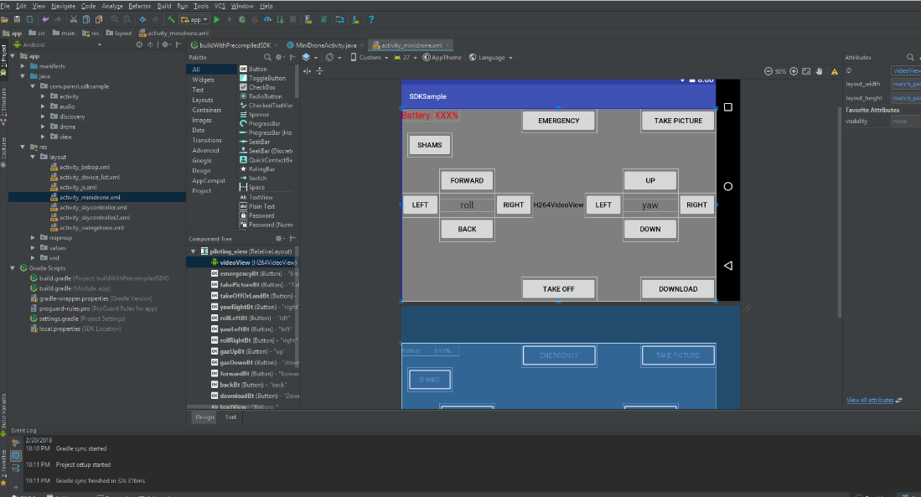

Slide 5
Computers and Java
1.1 Why Program?
1.2 Computer Systems: Hardware and Software
1.3 Programming Languages
1.4 What is a Program Made Of?
1.5 The Programming Process
1.6 Object‐Oriented Programming

Slide 6
Why Program?
To use computers to perform many functions
Syntax ‐ rules of programming languages that must be followed

Slide 7
Computer Systems: Hardware and Software
Hardware ‐ physical pieces of the computer
CPU | Processor, Central Processing Unit | "brains" | Fetch, decode, execute
RAM | Random Access Memory, Main Memory, Primary Memory | Volatile form of storage (contents are lost when power is lost) | Stores portions of currently running programs and data
Secondary Storage Devices | Hard drive (Magnetic, Solid State) USB Stick Floppy Disk CD | Non‐volatile form of storage (contents are not lost when power is lost) | Stores information for longer periods of time
Input Devices | Keyboard, mouse, microphone, webcam, barcode reader |  | Collect data from outside world
Output Devices | Monitors, speakers, printers, fax, projector |  | Send data to the outside world

Slide 8
Software
Software ‐ Programs that run on a computer
Operating Systems (OS) | Windows, Mac OS, Linux, Android, iOS | Manage computer's resources
Applications | Microsoft Word, Google Chrome, Safari, Firefox, Opera, Steam, PhotoShop, Photos, AutoDesk, Eclipse, Blender, Clash of Clans, Facebook, Maps, Discord | Specific Tasks
types:

Slide 9
What is a Program Made Of?
Programming Language, 5 elements:
1. Keywords | Reserved words in the Java language
2. Operators | Apply to values in expressions
3. Punctuation | Separate and enclose elements
Programmer‐Defined Identifiers | Names that the programmer creates
5. Syntax | Rules for combining (1) ‐ (4)

Slide 10
2. Java Fundamentals
Parts of a Java Program
The print and println Methods and the Java API
Variables and Literals
Primitive Data Types
Arithmetic Operators
Combined Assignment Operators
Creating named constants with final
The String Class
Scope
Comments
Programming Style
Reading Keyboard Input
(Optional) Common Errors to Avoid

Slide 11
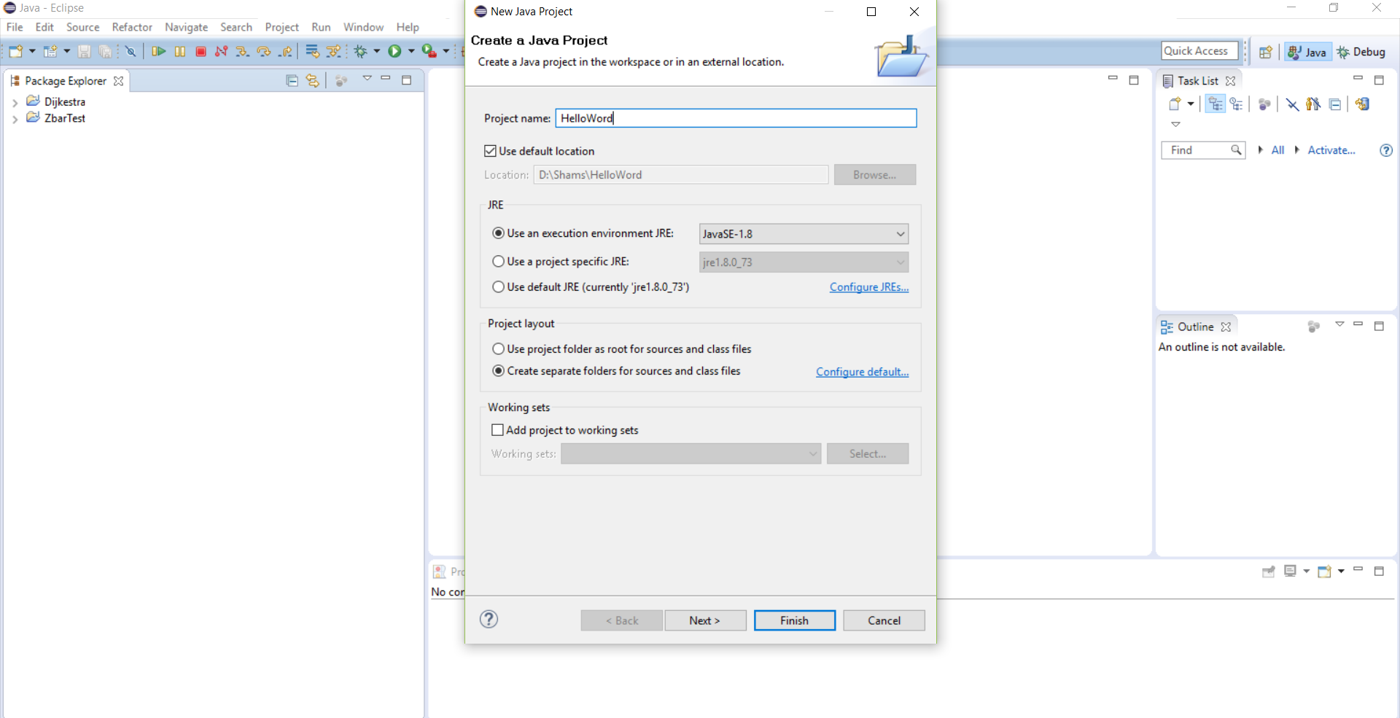
Creating a project
Go to File->New…->Java Project
You can use System.out.print(Object); to print a String to the console. You can use System.out.println(Object); to print a String followed by a newline to the console.
Now press the ‘Run’ button to execute the program! You should get the output in the Console tab at the bottom of the window.
For the project name, use for example : HelloWord. And press finish

Slide 12
Parts of a Java Program
// This is a simple Java program.
public class Simple
{
public static void main(String[] args)
{
System.out.println("Programming is great fun!");
}
}
Every Java program needs a main method.
Braces must be balanced.
Statements are terminated with semicolons.
Java is a case-sensitive language.
All Java programs must be stored in a file with a .java extension.
The filename must be the same as the class name.
Comments are ignored by the compiler.
A .java file may contain many classes but may only have one public class.
If a .java file has a public class, the class must have the same name as the file.

Slide 13
Comments
Comment Style | Description
// | Single line comment
/* … */ | Block comment. Everything /* and */ is ignored.
/** … */ | Javadoc comment

Slide 14
The print and println methods and the Java API
System.out.println("The cat sat"); System.out.println("on the mat");
Output:
The cat sat on the
Mat
System.out.print("The cat sat"); System.out.print("on the mat");
Output:
The cat saton the mat
The println method places a newline character at the end of whatever is being printed out.
The print method does not place a newline character at the end of whatever is being printed out.

Slide 15
Java Escape Sequences
System.out.print("The cat sat\n");
System.out.print("on the mat");
Output:
The cat sat
on the mat
\n | Advances the cursor to the next line
\t | Prints a tab
\b | Causes the cursor to back up one position
\r | Causes the cursor to move to beginning of the current line
\\ | Prints a \
\' | Prints a '
\" | Prints a "

Slide 16
System.out.print("These are our top sellers:\n"); System.out.print("\tComputer games\n\tCoffee\n"); System.out.print("\tAspirin");
System.out.print("These are our top sellers:\n\tComputer games\n\tCoffee\n\tAspirin");
Output:
These are our top sellers:
Computer games
Coffee
Aspirin

Slide 17
Variables and Literals
A variable is a named storage location in the computer's memory
A literal is a value that is written into the code of a program
double itemCost = 82.50;
double tr = 0.0725;
double salesTaxRate = 0.0725
Java programs should be "self-documenting"

Slide 18
Primitive Data Types
Variables have a name and a data type.
Java has 8 primitive data types:
byte | Integers in the range -128 to 127
short | Integers in the range -32,768 to 32,767
int | Integers in the range -2,147,483,648 to 2,147,483,647
long | Integers in the range -9,223,372,036,854,775,808 to 9,223,372,036,854,775,807
float | Floating-point (decimal) numbers in the range of -3.4 x 10^38 to 3.4 x 10^38 7 digits of accuracy
double | Floating-point (decimal) numbers in the range of -1.7 x 10^308 to 1.7 x 10^308 15 digits of accuracy
boolean | true or false
char | characters

Slide 19
int counter = 0;
float percentage = 0.06; boolean isValid = true; char myCharacter = '1'; char myCharacter2 = 'a';
= | Assignment Operator (assigns what is on right to what is on left)
initialize | Assign a value for the first time
Ex.
double rate = 50; int hours = 40;
double pay = rate * hours;

Slide 20
Arithmetic Operators
Java has 5 arithmetic operators:
+ | Addition | total = cost + tax;
- | Subtraction | cost = total - tax;
* | Multiplication | tax = cost * rate;
 | Division | salePrice = original / 2;
% | Modulus | remainder = value % 5;

Slide 21
Combined Assignment Operators
x = x + 5; // adds 5 to x and stores result
// back in x
Operator | Example | Equivalent
+= | x += 5; x += z; | x = x + 5; X = x + z;
-= | x -= 5; x -= y; | x = x - 5; x = x - y;
*= | z *= 10; | z = z * 10;
/= | a /= b; | a = a / b;
%= | c %= 3; | c = c % 3;

Slide 22
Errors
Syntax | Error in combining elements of the programming language Cause program to fail to compile Compile‐time error
Logical | Error in the calculations in the program Won't prevent program from compiling, but will result in anomalous output
Run‐time error | Errors that occur after the program is started Logical Error Other types of run‐time errors

Slide 23
Creating named constants with final
Constants - a special type of variable whose value cannot
change after it has been initialized
Constants are declared using keyword final
Once initialized, constants cannot be changed.
By convention, constants are all upper case words separated by underscores
final double CAL_SALES_TAX = 0.0725;

Slide 24
The String Class
Java has no primitive data type that holds a series of characters.
The String class is used to store strings of text.
Notice the S in String is upper case.
Reference variable
Refers to an object in memory
Not a primitive data type, which are not represented as objects in memory
A (reference) variable can be assigned a String literal
String value = "Hello";
OR
String value = new String("Hello");
public class StringDemo{
public static void main(String[] args){
String greeting = "Good morning, ";
String name = "Herman";
char closing = '!';
System.out.println(greeting + name + closing);
}
}
Output:
Good morning, Herman!

Slide 25
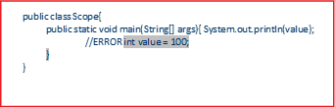

Scope

Slide 26
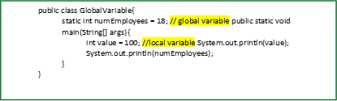
Scope - the part of the program that has access to a variable
• local variables - variables declared inside a method (like the main method)
• global variables - variables declared outside a method
• Local variables' scope begins at the declaration of the variable and ends at the end of the method in which it was declared.
• Global variables' scope begins at declaration of the variable and ends at the end of the class in which it was declared.

Slide 27
Reading Keyboard Input
To read input from the keyboard, use the Scanner class.
The Scanner class is defined java.util
import java.util.Scanner;
To create a Scanner object:
Scanner keyboard = new Scanner(System.in);
System.in means make the Scanner object read input from the keyboard

Slide 28
Scanner methods:
Method | Example | Description
nextDouble | double number; Scanner keyboard = new Scanner(System.in); System.out.println("Enter a value: "); number = keyboard.nextDouble(); | Return input as a double.
nextInt | int val; Scanner keyboard = new Scanner(System.in); | Return input as an int.
 | System.out.println("Enter a value: "); number = keyboard.nextInt();
nextLine | String name; Scanner keyboard = new Scanner(System.in); System.out.println("Enter your name: "); name = keyboard.nextLine(); | Return input as a String.

Slide 30
Telling Story
1- Set total number of gold prices to 900
2- Welcome player to game
3- Get string from player for leader's last name
4- Get positive number from player for number adventurers
that begin journey
6- Get positive number from player, less than first,
for number adventurers killed
8- Calculate number adventurers who survive battle
9- Calculate number of gold pieces left over after
survivors split loot
11- Story using values from player and calculated values

Slide 31
import java.util.Scanner;
public class TellingStory {
public static void main(String[] args) {
// define constant
final int GOLD_PIECES=900;
// declear varianles
String leader; //last name of leader
int adventurers; // number of adventurers that begin journey
int killed; // number of adventurers killed
/* Getting information from the player*/
//get values
System.out.print( "\t Welcome to lost Fortune \n\n");
System.out.print( " Please enter the following for a personalized adventure.\n\n");
System.out.print( " Enter your last name: ");
Scanner keyboard = new Scanner(System.in);
leader = keyboard.nextLine();
System.out.print("\n");
System.out.print( "Enter a positive number: ");
adventurers = keyboard.nextInt();
System.out.print("\n");
System.out.print("Enter a positive number . less than the first : ");
killed= keyboard.nextInt();
System.out.print("\n");
// calculate new values
int survivors = adventurers-killed;
int extraGoldPieces= GOLD_PIECES % survivors;
// tell the story
System.out.print("\n");
System.out.print("The brave "+leader+" led of group of "+adventurers);
System.out.print( "adventurers on a quest.\n" );
System.out.print("They fought a band of ogres and lost "+killed+"...only ");
System.out.print(survivors+ " survived."+"\n");
System.out.print("The party was about to give up when they stumbled upon a\n");
System.out.print( "buried fortune of "+ GOLD_PIECES+" gold pieces.");
System.out.print( "They split the loot and \n");
System.out.print( leader+" kept the extra "
+extraGoldPieces+" gold pieces(s)");
System.out.print("to keep things fair.\n");
}}

Slide 32
3. Decision Structures
The if Statement
The if-else Statement
Nested if Statements
The if-else-if Statement
Logical Operators
Comparing String Objects
The Conditional Operator
The switch Statement
The System.out.printf method

Slide 33
The if Statement
• Causes a statement or group of statements to run if a condition is true.
• The statement or group of statements is simply skipped if the condition is false.
• General Format:
if (condition)
{
statement1;
statement2;
….
}
• If there is only one statement, you can drop the curly braces:
if (condition)
statement1;

Slide 35
Relational Operators
> | Is Greater Than
< | Is Less than
>= | Is Greater Than Or Equal To
<= | Is Less Than Or Equal To
== | Is Equal To
!= | Is Not Equal To

Slide 36
Logical Operators

Slide 37
The Conditional Operator

Slide 38
The switch Statement

Slide 39
System.out.println("Welcome to the Bank Account program");
System.out.println("********************************************");
System.out.println("1- Check Balance");
System.out.println("2- Deposit Amount");
System.out.println("3- Withdraw Amount");
System.out.println("4- Exit");
System.out.println("Make your selection : ");
Scanner scan1=new Scanner(System.in);
input = scan1.nextInt();
switch(input)
{
case 1:
checkBalance();
break;
case 2:
Deposit();
break;
case 3:
wihtdraw();
break;
case 4:
System.out.println("Bye Bye ");
break;
default:
System.out.println("Invalid Choice");
}

Slide 40
4. Loops
The Increment and Decrement Operators
The while Loop
Using the while Loop for Input Validation
The do-while Loop
The for Loop
Running Totals and Sentinel Values
Nested Loops
The break and continue Statements
Deciding Which Loop to Use
Generating Random Numbers with the Random Class

Slide 41
The Increment and Decrement Operators
Increment Operator | ++
Decrement Operator | --

Slide 42
The while Loop
while (condition) {
statements;
}
• While the condition is true, the loop iterates.
• Pre-test loop - condition is checked prior to executing the loop.
• Infinite loop - A loop that never terminates

Slide 43
The do-while Loop
do {
statements;
}
while (condition);

Slide 44
The for loop

Slide 46
Nested Loops
Nested loop - one loop inside another
Inner and Outer loop
Inner loop will execute all of its iterations for every one execution of the outer loop

Slide 47
The break and continue Statements
• break Statement
• Terminates a loop
• continue Statement
• Causes the currently executing iteration of a loop to terminate
Then the next iteration begins

Slide 48
Deciding which Loop to Use
Use | where there is some type of counting variable that | can | be | evaluated | for
Use | where you want the statements to execute at least | one time |  |  | do while
Use the | where you do not want the statements to execute if beginning | the condition is false in |  |  | while

Slide 49
int input;
do
{
System.out.println("Welcome to the Bank Account program");
System.out.println("********************************************");
System.out.println("1- Check Balance");
System.out.println("2- Deposit Amount");
System.out.println("3- Withdraw Amount");
System.out.println("4- Exit");
System.out.println("Make your selection : ");
Scanner scan1=new Scanner(System.in);
input = scan1.nextInt();
switch(input)
{
case 1:
checkBalance();
break;
case 2:
Deposit();
break;
case 3:
wihtdraw();
break;
case 4:
System.out.println("Bye Bye ");
break;
default:
System.out.println("Invalid Choice");
}
} while (input != 4);
}

Slide 50
Methods
Introduction to Methods
Passing Arguments to a Method
More about Local Variables
Returning a Value from a Method
Problem Solving with Methods

Slide 51
Method - bundle of statements that performs a particular task

Slide 52
Passing Arguments to a Method
Argument - Value that is passed into a method when it is called
• The data type of an argument in a method call must correspond to the variable declaration in the parentheses of the method definition
Java will automatically perform widening conversions
(int where a double is expected) but narrowing conversions (double where an int is expected) will cause a compiler error
public static void showSum(double num1, double num2)
{ double result = num1 + num2;
System.out.println("The sum is " + result);
}
showGreeting(18, "Justin");
public static void showGreeting(int age, String name)
{ System.out.println("Hi, Your name is " + name);
System.out.println("Your age is " + age);
}

Slide 53
More about Local Variables
• A local variable is declared inside a method
• Local variables only have scope from line in which
they are declared to the end of the method in which they are declared.
• Different methods can have local variables with the same name.
• When the method ends, the local variables (including the parameter variables) are destroyed and any values stored are lost.
• Local variables are not automatically initialized with a default value and must be given a value before they can be used.

Slide 54
Returning a Value from a Method
/**
*This method adds two numbers
*@param num1 our first number to add
*@param num2 our second number to add
*@return returns the sum of the two integer values
*/
public static int sum(int num1, int num2){ return num1 + num2;
}
/*
This method displays the full name.
@param firstName the first name
@param lastName the last name
@return the full name
*/
public static String fullName(String firstName, String lastName){ return firstName + " " + lastName;
}

Slide 55
ATM Project
NOTE: Minimum requirement to qualify for grading: 1) Code must be properly indented, modularized and follows the best practices. Account Project (A bank account has methods to deposit, withdraw, and check the balance.) (100 points) 1. The program contains 3 main variables called accountBalance, accountName and accountNum. Choose appropriate data types for these variables 2. initializes the accountName with the parameter specified. The member variables accountBalance and accountNum are assigned some random value (No need to use rand function). 3. The program will contain member functions named menu, withdraw, and deposit The withdraw function checks to see if balance is sufficient for withdrawal. If so, decrements balance by amount; if not, prints an appropriate message indicating insufficient funds and displays the current balance. The deposit function adds deposit amount to balance and displays new balance The menu function will contain the following menu options: 1. Check Balance, 2. Deposit Amount, 3. Withdraw Amount, 4. Exit. Use appropriate messages for each option selected and then call the correct function to perform the task.
Output:
Welcome to the Bank Account program Here is your Initial Account Information: Account for: Helen Account #: 123456 Balance: $187.5
************************ Menu ************************ 1. Check Balance 2. Deposit Amount 3. Withdraw Amount 4. Exit
Please make a selection: 8
ERROR: Invalid choice. Please try again !!!

Slide 56
import java.util.Scanner;
public class ATM {
static int accountBalance = 100;
static int AccountNum=123456;
static String AccountName="Helen";
public static void main(String[] args) {
// TODO Auto-generated method stub
Menu();
}
public static void Deposit()
{
int val;
Scanner keyboard = new Scanner(System.in);
System.out.println("Enter a value: ");
val= keyboard.nextInt();
accountBalance = accountBalance+val;
System.out.printf("Current Balance is " + accountBalance);
System.out.println("");
}
public static void wihtdraw() {
int val;
System.out.println("Enter a value: ");
Scanner keyboard = new Scanner(System.in);
val= keyboard.nextInt();
if (val> accountBalance) {
System.out.println("insufficient funds ");
System.out.printf("your current balance is: "+ accountBalance);
} else
accountBalance-= val;
System.out.printf("Current Balance is " + accountBalance);
System.out.println("");
}
public static void checkBalance(){
System.out.println("Name : " + AccountName);
System.out.println("Number : " + AccountNum);
System.out.println("Balance : " + accountBalance);
}

Slide 57
public static void Menu() {
int input;
do
{
System.out.println("Welcome to the Bank Account program");
System.out.println("********************************************");
System.out.println("1- Check Balance");
System.out.println("2- Deposit Amount");
System.out.println("3- Withdraw Amount");
System.out.println("4- Exit");
System.out.println("Make your selection : ");
Scanner scan1=new Scanner(System.in);
input = scan1.nextInt();
switch(input)
{
case 1:
checkBalance();
break;
case 2:
Deposit();
break;
case 3:
wihtdraw();
break;
case 4:
System.out.println("Bye Bye ");
break;
default:
System.out.println("Invalid Choice");
}
} while (input != 4);
}
}

